Slide 1
Asynchronous JavScript
Jeton Mustini

Slide 2
Table of contents
Synchronous vs Asynchronous code
What is asynchronous code used for?
Asynchronous code with callbacks
Asynchronous code with promises
Asynchronous with async - await

Slide 3
synchronous vs ASynchronous
Synchronous
Each statement is executed in sequence
Each statement waits for the previous statement before executing
Asynchronous
Doesn’t have to wait for previous statement
Can continue to run next statement before previous statement finishes
time
time
Problems with synchronous code
Time-consuming operations block further execution until they finish
Makes the UI or server unresponsive until the function returns
Results in terrible user-experience

Slide 4
What is Asynchronous code used for?
Examples
Time-consuming operations and calculations
Making API calls to a remote server
Reading and writing to a database
Logging in and out a user
…

Slide 5
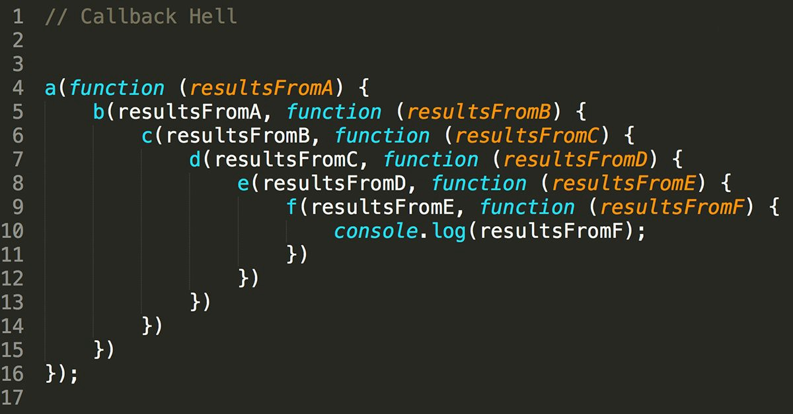
Asynchronous code with callbacks
When you want to compute time-consuming task, just pass another function as argument that should run after task completion.
Problem that nested calls grows with every asynchronous action.
Hard to read, maintain and sometimes called “callback hell”.

Slide 6









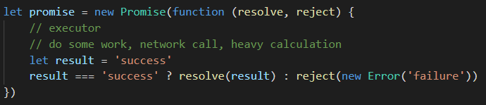
Creating Promises
request
promise
response
A promise is an object that may produce a single value at some time in the future.
The value is either resolved or a reason it was not resolved an error.
A promise may be in 3 different states fulfilled, rejected, or pending.
The function passed to new promise is called executor. Runs automatically when new promise is created.
Its arguments resolve and reject are callbacks provided by JavaScript itself.
resolve(value) – if the job finished successfully, with the result value.
reject(error) – if an error occurred, error is the error object.

Slide 7
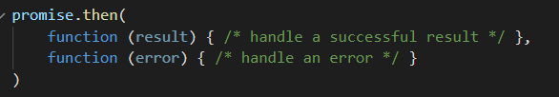
Consuming Promises
Consuming functions can be registered (subscribed) using methods:
.then
.catch
.finally
The first argument of .then is a function that runs when the promise is resolved, and receives the result.
The second argument of .then is a function that runs when the promise is rejected, and receives the error.

Slide 8
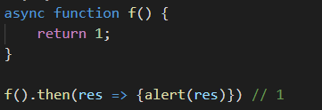
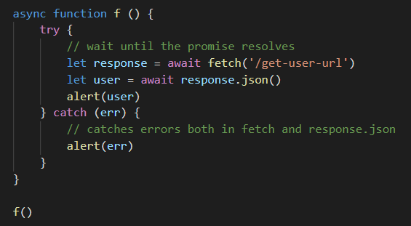
Asynchronous code with Async-await
Another way of doing asynchronous code which some prefer over promises
async keyword is added before a function and has two affects:
Makes it always return a promise
Allows await to be used in it
The await keyword before a promise makes JavaScript wait until that promise settles, and then:
If an error occurs, the exception is generated
Otherwise, it returns the result

Slide 9
Slide Tite
I’m done, I promise!

